Slide 1
CourseLENS : Course Aware AI Learning Platform
Intelligent Educational RAG Platform for High-Trust Learning
Presented By : Jyothssena Gomatum Sreenivasan and Sharan Giri

Slide 2
What Real World Problem Are We Tackling?
Imagine it’s 11 PM. You have a final exam tomorrow morning.
You are reviewing 'Dynamic Programming,' but you hit a wall. You frantically flip through your handwritten lecture notes, looking for that one specific example the professor gave. But when you find it, it’s just a mess of hasty scribbles, arrows and numbers that made sense in the moment, but are completely incomprehensible now.
You need an explanation NOW, but TA office hours ended at 5 PM. You are completely on your own.
You try to decipher the textbook, but it's too dense. You consider searching online, but you don't have time to sift through hours of unrelated videos.
So, you make the best choice you can.
You give up.
You close the book, turn off the lights, and simply hope that 'Dynamic Programming' isn't on the test

Slide 3
Who Are Affected & Why Is This Problem Important?
Students are stuck learning alone, forced to rely on confusing, generic AI when they need specific help late at night. This leaves instructors overwhelmed, unable to personally answer every student's question 24/7. This creates a silent gap where misconceptions grow unchecked, leading to poor performance and academic frustration
1. Learning vs. Gambling
Education shouldn't be about luck. When students skip topics because they can't find help, they leave gaps in their knowledge that hurt them later. We need to turn "hoping it's not on the test" into "mastering the concept."
2. The "Context Gap"
Generic tools like ChatGPT don't know your specific class. They give answers that might be technically "right" but are "wrong" for your exam (using methods you haven't learned yet). Students need answers that match their syllabus.
3. Support That Scales Better
The Point: Learning happens 24/7, but humans (TAs/Professors) can't be there 24/7. When a student gets stuck at midnight, the learning stops. We need an automated system that provides instant, expert-level help whenever the student is ready to learn

Slide 4
What Impact We Hope To Make
1. Active Learning (The Guide)
The Shift: We move from "giving answers" to "guiding thoughts."
How: CourseLENS doesn't just solve the problem. It gives hints and asks questions, forcing the student to think and actually learn the material.
2. Academic Integrity (The Guardrail)
The Shift: We move from "cheating tool" to "honest tutor."
How: The system is built to explain how to do the work, not to do the work for them. It respects the rules of the assignment.
3. Verifiable Trust (The Proof)
The Shift: We move from "confident guessing" to "verified facts."
How: We implement Strict Context Grounding. The model is instructed to answer only based on retrieved information.
Behaviour : No Context Hallucinations. Every answer is backed by a direct citation to lecture document or slide, so students and professors know it's accurate. If a user asks a question outside the scope of the lectures (e.g., material from a future semester), the model will explicitly reply: "I cannot find relevant context in the course materials to answer this question."

Slide 5
DATA DESCRIPTION
We are building a closed-loop system that ingests only verified course assets:
Lecture Slides (PDFs): To capture visual schemas, diagrams, and key definitions.
Lecture Notes & Transcripts: To capture the professor’s spoken explanations, ensuring we catch the nuance that isn't on the slides.
Assignments & Rubrics: To understand the grading criteria, constraints, and specific project requirements.

Slide 6
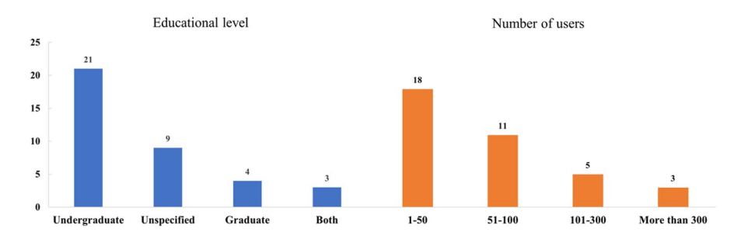
Related Works
Paper 1: Systematic Review of Educational AI Chatbot Studies
MA, W., MA, W., HU, Y. et al. The who, why, and how of ai-based chatbots for learning and teaching in higher education: A systematic review. Educ Inf Technol 30, 7781–7805 (2025). https://doi.org/10.1007/s10639-024-13128-6
Understanding “who” the users are

Slide 7
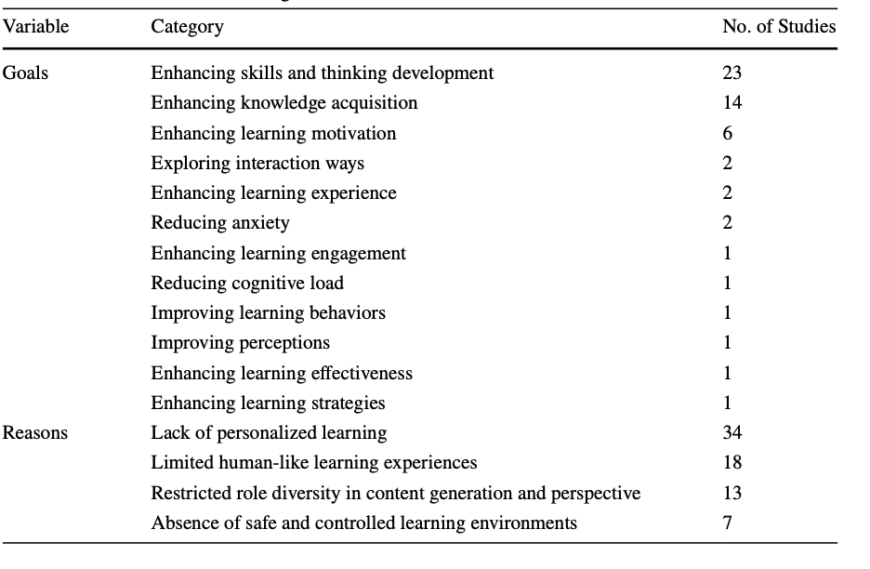
Related Works
Understanding user needs
Paper 1:
Understanding “who” the users are

Slide 8
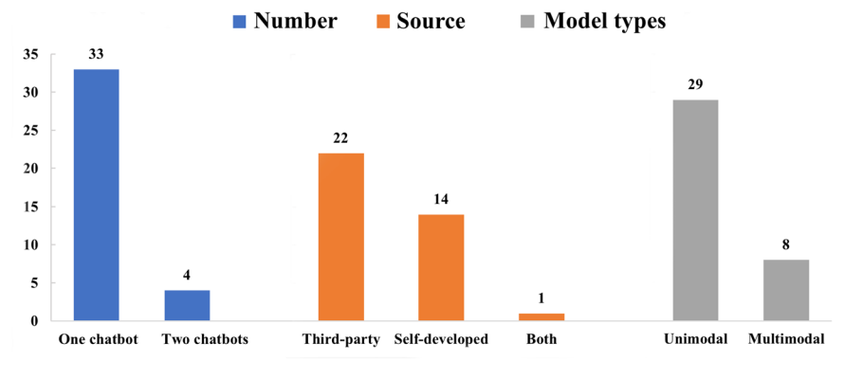
Related Works
Types of models used
Paper 1:

Slide 9
Related Works
Paper 2: LLMs for the Classroom with Knowledge- Based Retrieval
Amay Jain, Liu Cui, Si Chen Aligning LLMs for the Classroom with Knowledge-Based Retrieval -- A Comparative RAG Study
This research compares different Retrieval Augmented Generation (RAG) approaches for making LLMs more reliable in classroom settings.
The team created EduScopeQA, a dataset with 3,176 questions across History, Literature, Science, and Computer Science, to test how well vector-based RAG (OpenAI Vector Search) versus graph-based RAG (GraphRAG Local and Global) handle educational queries

Slide 10
Related Works
Paper 2: LLMs for the Classroom with Knowledge- Based Retrieval
OpenAI Vector Search RAG works well as a low-cost option for quick fact retrieval
GraphRAG Global excels at providing rich, curriculum-aligned explanations for thematic questions
GraphRAG Local achieves highest accuracy with dense textbook content when curriculum fidelity is critical
GraphRAG has 10-20x higher resource costs compared to vector-based approaches

Slide 11
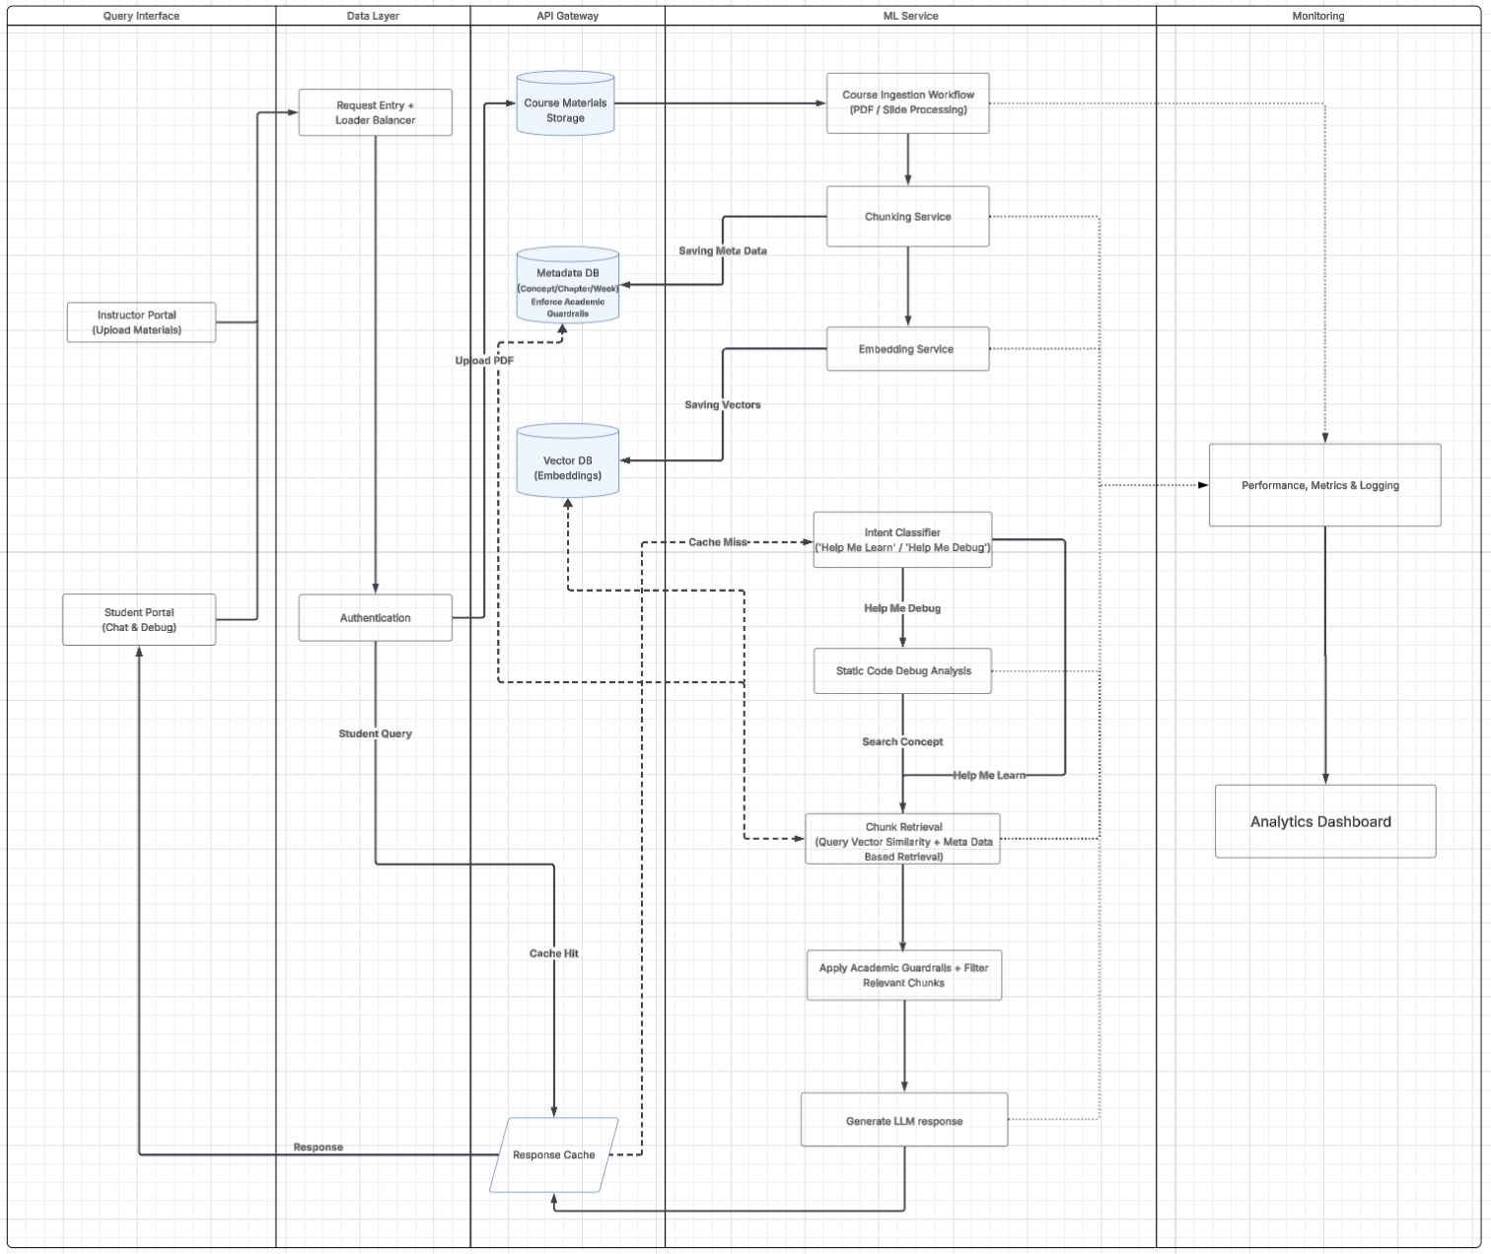
System Design

Slide 12
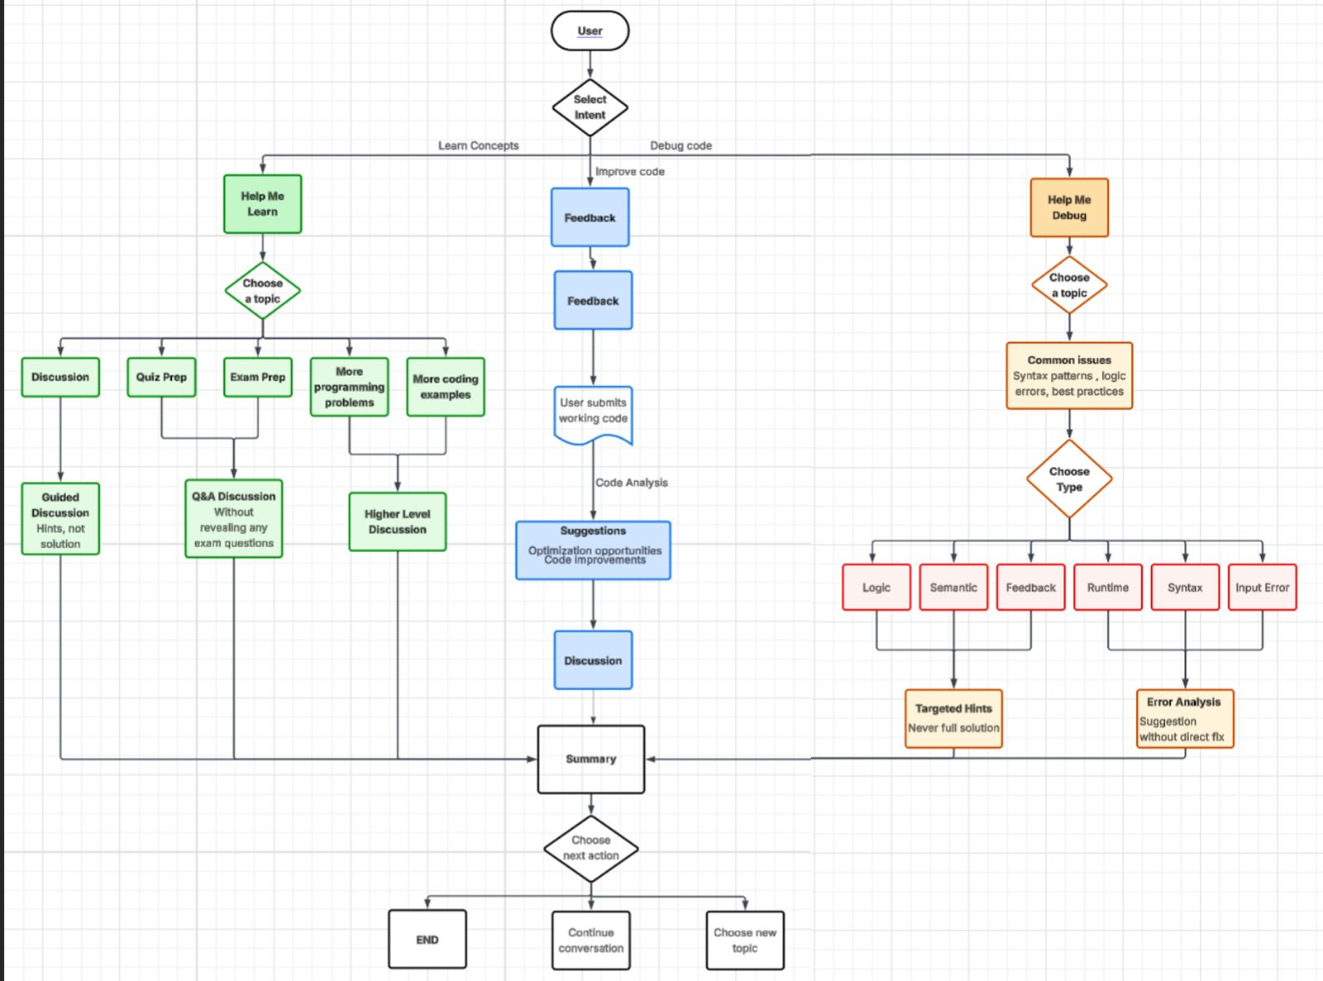
User Flow Diagram

Slide 13
A. Team Objectives
The Goal: To design the architecture for CourseLens, a reliable AI platform that addresses the "context gap" in online education.
Definition of Success (Milestone 1):
Validation: Successfully identifying the optimal RAG framework that supports syllabus-aware retrieval.
Blueprint: Establishing a clear technical roadmap for integrating Temporal Filtering and Guardrails before writing production code.
B. Individual Roles
What Jyothssena is working on:
Data Ingestion Research: Evaluating tools for accurate PDF transcribing and text extraction from slide decks.
System Logic Design: Exploring way to add temporal filtering, and guardrails to teach the AI to respect the syllabus constraints.
Next Steps :
Designing the System Prompts (Guardrails) and test data ingestion process.
What Sharan is working on:
RAG Architecture Evaluation: Comparing different retrieval strategies to see which works best for educational content.
Tech Stack Evaluation : Reviewing the codebase of a previous project to determine how we can use it as a foundation.
Next Steps :
Expand on code base to cater to initial version of this project and integrate data ingestion pipeline.

